Slide 1


cs 584 machine Learning Project Presentation
Priyank Shah (A20344797)
Shilpa Mandal (A20343042)

Slide 2
Cardiac Arrest Classification Using Feature Reduction Technique
Problem Statement : Classify arrhythmia cardiac arrest into the seven categories using machine learning techniques.
Data : Patient Records comprising of 279 features. The 452 records need to be segregated into 16 class distribution of type of Arrhythmia disease (1 for Normal, 2 - 16 for various categories)

Slide 3
Problems
How to handle large number of features?
How to achieve accurate prediction using Machine Learning algorithms in comparatively lesser time and higher accuracy?
To find better alternative to existing approach Neural Networks (BPNN back propagation neural network).

Slide 4
Proposed Solution
In this research we have tried classify arrhythmia cardiac arrest into the 16 categories by applying machine learning algorithm like
PCA (principal component analysis) for feature reduction.
And further using the reduced features to build various models using ELM (extreme learn machine), KNN (K Nearest Neighbor) and RF (Random Forest).

Slide 5
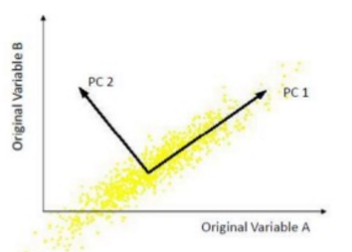
Principal Component Analysis PCA
A linear projection method to reduce the number of parameters by mapping the features into a space of lower dimensionality.
The first principal component is the direction of greatest variability(covariance) in the data. Second is the next orthogonal (uncorrelated) direction of greatest variability, and so on.
In PCA, covariance (or correlation) matrix is split into scale part (eigen values) and direction part (eigenvectors).

Slide 6
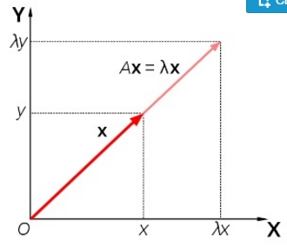
Advantage of PCA
PCA identifies correlation in data and helps in feature extraction and selection.
Since patterns in data can be hard to find in data of high dimension, PCA is a powerful tool for analyzing data.
The data gets compressed without much loss of information.
Using PCA we reduced our feature set from 278 to 79 principal components.

Slide 7
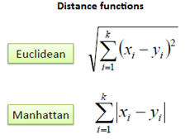
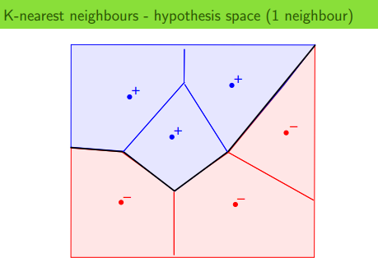
K Nearest Neighbor
KNN is a simple and lazy learning or instance based learning algorithm
It stores all available cases and classifies new cases based on similarity matrix. A distance measure is needed to determine the "closeness" of instances
Then an instance is classified by finding its nearest neighbors and by picking the most popular class among the neighbors.
It can be useful to assign weight to the contributions of the neighbors, so that the nearer neighbors contribute more to the average than the more distant ones.

Slide 8
Extreme Machine learning ELM
Gradient based algorithm like BPNN adjusts weights between neurons from output layer to input layer. In practice slower due to improper learning steps or easily converge to local minima.
Popular machine learning techniques like Neural Network (NN) and support vector machine (SVM) face some challenging issues such as: intensive human intervene, slow learning speed.
Though this process there exists dependency between input weights and output weights.
ELM which overcomes defects of BPNN is a novel learning
algorithm for SLFN single hidden layer feedforward network.

Slide 9
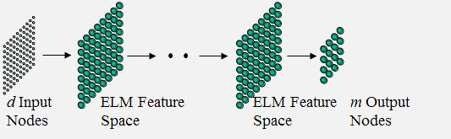
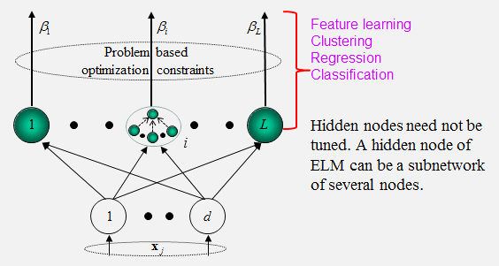
ELM considers multi-hidden-layer of networks as a white box and trained layer-by-layer.
ELM are single layered feed forward neural network for classification or regression. Here where the weights connecting inputs to hidden nodes are randomly assigned and never updated.
These weights between hidden nodes and outputs are learned in a single step, which essentially amounts to learning a linear model.

Slide 10
Advantage of ELM
The prediction performance of ELM is usually the bit better then these techniques.
ELM is much faster than the traditionally used gradient descent. This is due to optimal coefficients, which are calculated using an algebraic calculation instead of an iterative stochastic method.
ELM substantially decreases the computational time spent in adjusting the weights since it does not use any search method for fitting the hidden weights.

Slide 11
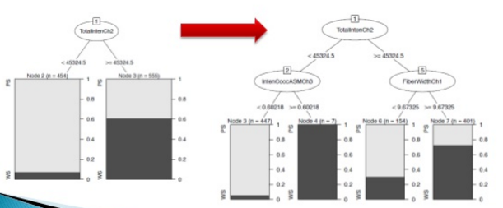
Random Forest RF
Decision Trees Learning is one of the most widely used and practical methods for inductive inference and is an important tool in machine learning or predictive analytics
Random Forest are an ensemble learning method for classification, regression and other tasks, that operate by constructing a multitude of decision trees at training time.
The class that is the mode of the classes (classification) or mean prediction (regression) of the individual trees are the predictions.
This is an very effective technique of decreasing the variance of the model, without increasing the bias resulting bootstrapping procedure leads to better model performance.

Slide 12
Conclusion
Feature Reduction Technique reducing significant amount of execution time and increase the efficiency.
PCA algorithm simply helps in reducing dimension and easily use with any other algorithm like SVM, Naïve Bayes, Knn.
Random Forest algorithm is more efficient as, it plays both the roles of feature reducer and classifier.

